Slide 1
Improving Credit Card Services NLP Analysis of Consumer Complaints
Jun Tian
February 2021

Slide 2
Problem:
Given consumer complaint narratives on credit card, how could financial companies respond to make consumers satisfied?

Slide 3
Data and Methodologies
Data source: Consumer Financial Protection Bureau (CFPB) managed a Consumer Complaint Database
Data Duration: December 1, 2011 to current
Methodologies
Data Wrangling
Exploratory Data Analysis
Natural Language Process
Machine Learning for Classification

Slide 4
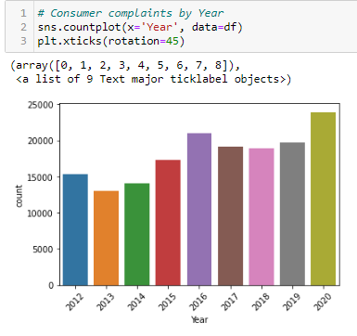

Slide 5
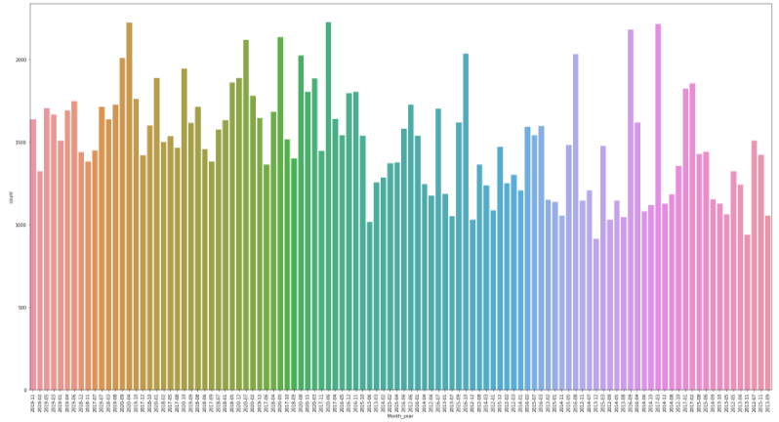

Slide 6
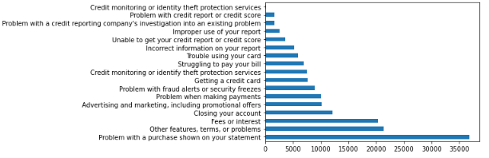

Slide 7
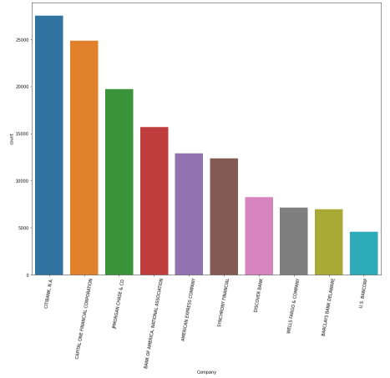

Slide 8
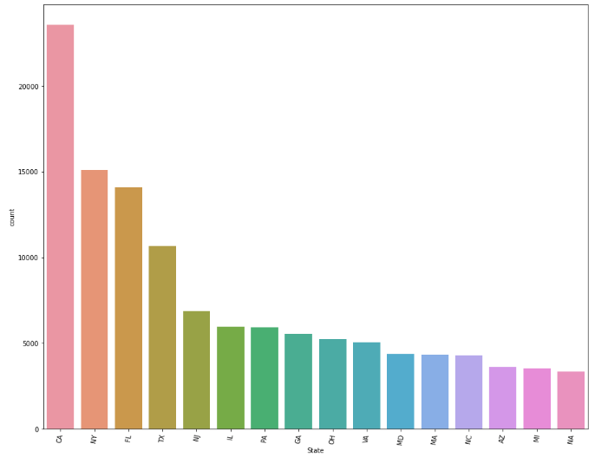

Slide 9
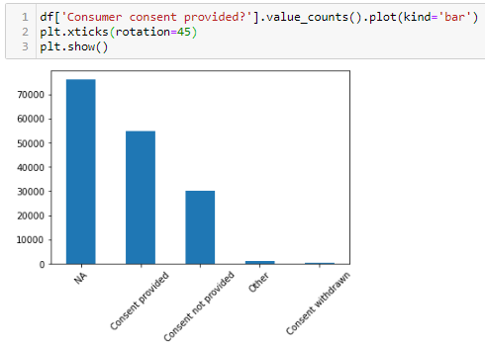

Slide 10
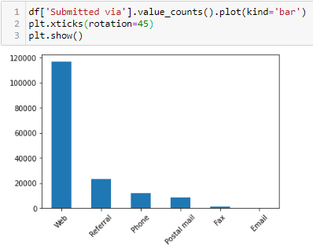

Slide 11
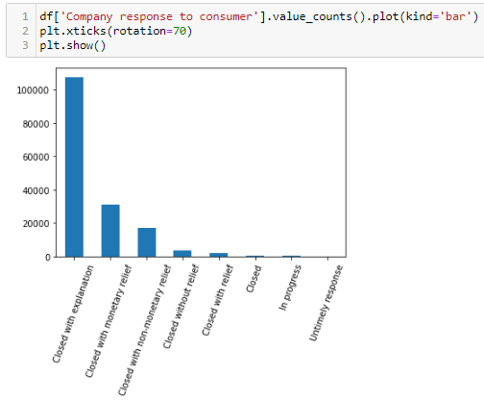

Slide 12
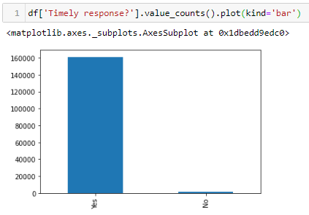

Slide 13
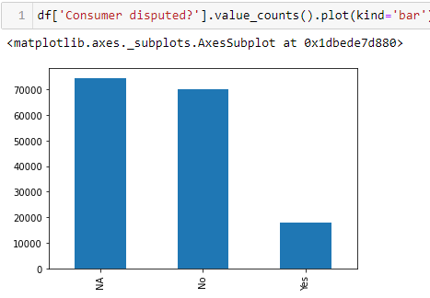

Slide 14
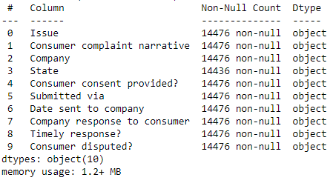


Slide 15

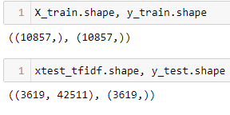
Multi-Classification with:
Logistic Regression
SVM
XGBoost

Slide 16
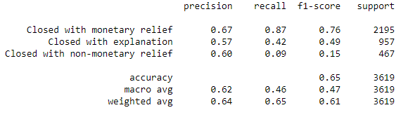
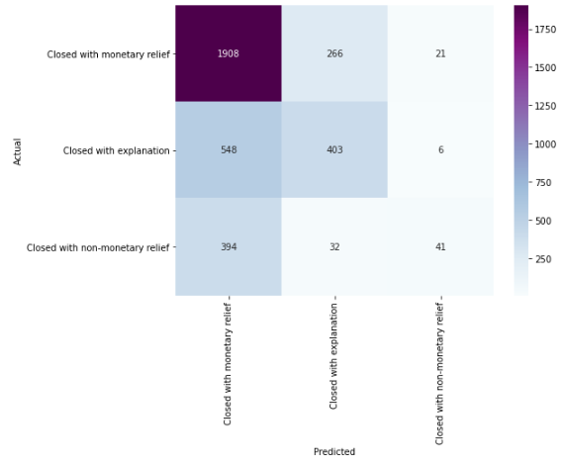
Logistic Regression

Slide 17
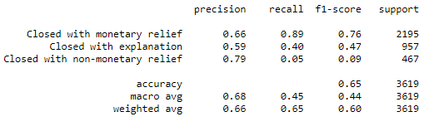
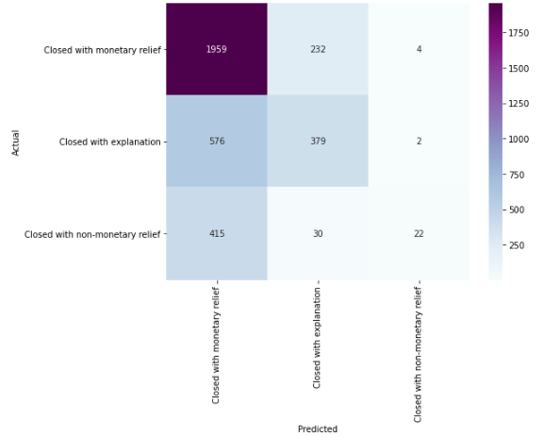
SVM

Slide 18
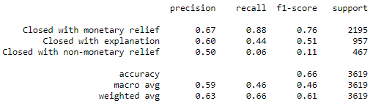
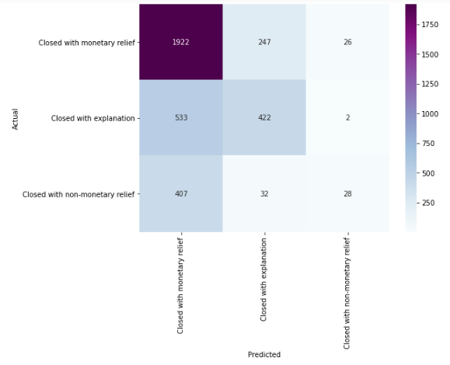
XGBoost

Slide 19
Findings and Recommendations
Our model provides a convenient and reliable way of classifying company responses, which can improve company effectiveness and save on human resources
Further improvement on modelling:
- Complete data information
- Using more recent data
- Combine with companies’ own database

